Slide 1
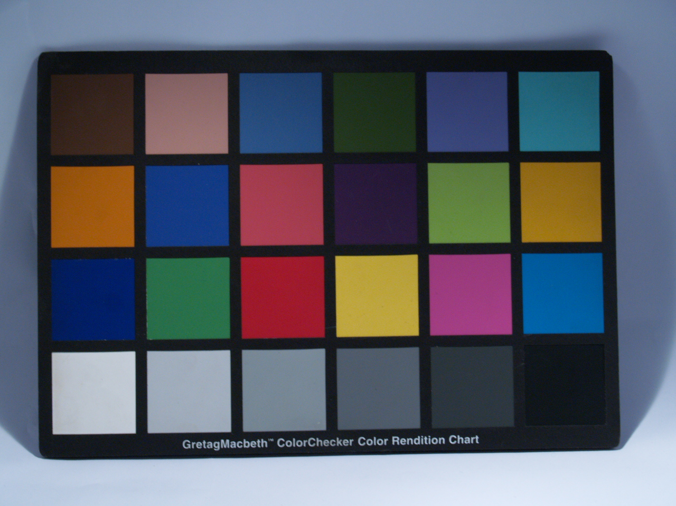
Color segmentation and processing
Rivera, mib
Physics 301 wfz
Fig. 1. Tan Macbeth Chart, width = 1280 pixels, height = 960 pixels

Slide 2
objectives
Use digital color histograms to segment regions of interest in an image.

Slide 3

Ways of segmenting colors
We first choose a region of interest and let the program recognize the colors in that region
Segmentation allows us to pick out the same colors as those identified in the ROI
For the Macbeth chart, we pick out the blue color in the second row from above (marked by red square)

Slide 4
Ways of segmenting colors
Thresholding
Models the color histogram of the ROI as a cube; outputs either 0 or 1
Parametric segmentation
Models the ROI histogram as an ellipsoid; outputs numbers between 0 and 1
Histogram backprojection
Transforms the histogram space to chromacity space then assigns the value for a specific pixel from that space back to the histogram

Slide 5
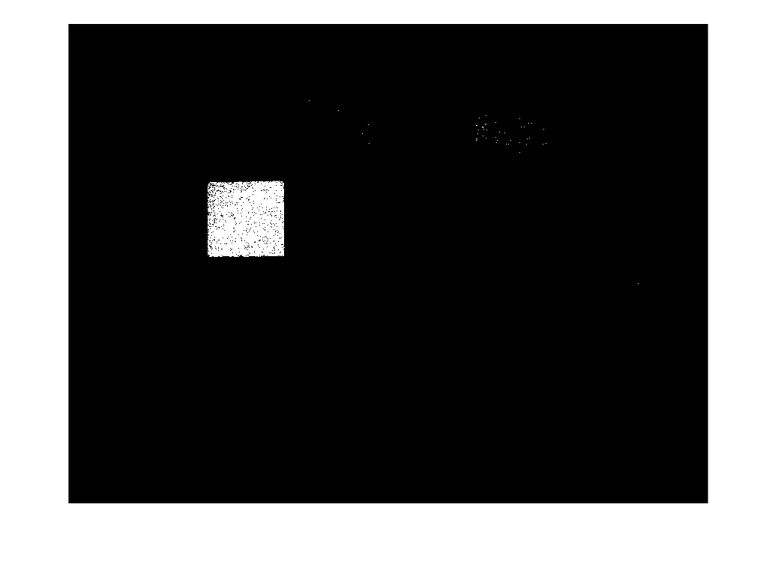
Thresholding
Can still pick out pixels from other regions; accuracy depends on the range noted from the histogram

Slide 6
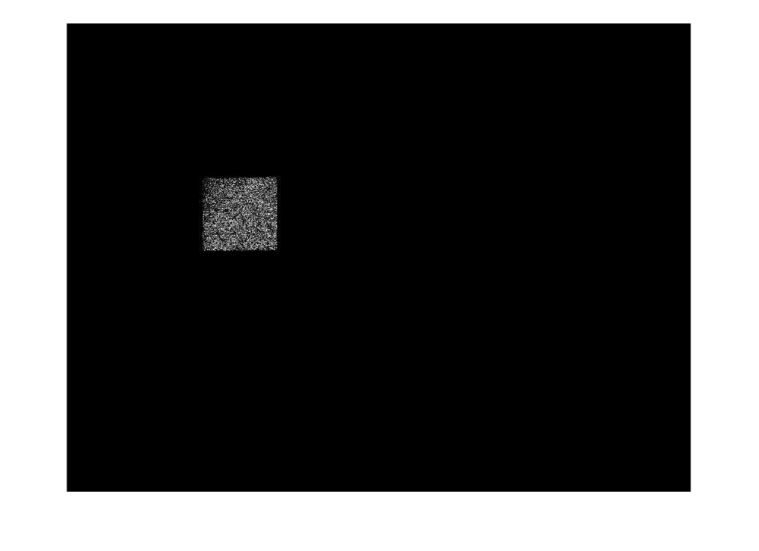
Parametric segmentation
Assigns values lower than 1 to the ROI; accuracy depends on the range (which depends on the std dev)

Slide 7
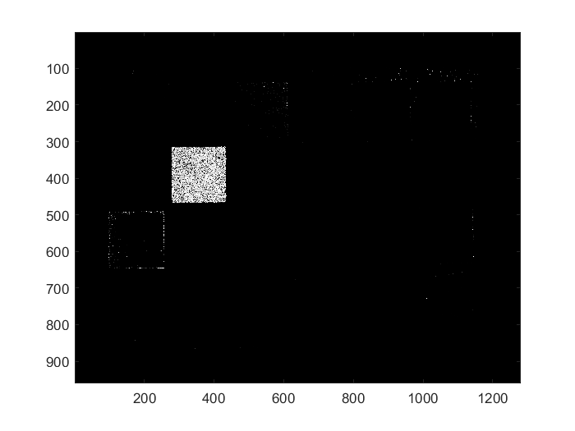
Histogram backprojection
Depends entirely on chromacity value per pixel; no need to compute anything or look for ranges

Slide 8
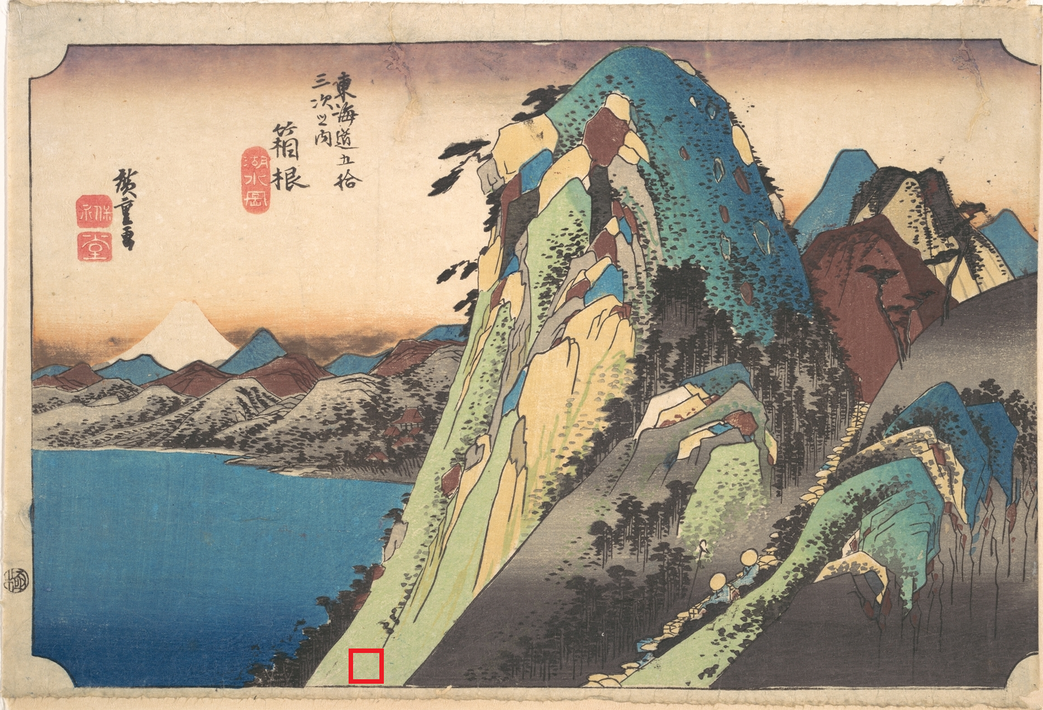
application
Red square at the bottom indicates ROI; image taken from the Met Museum public domain images.

Slide 9
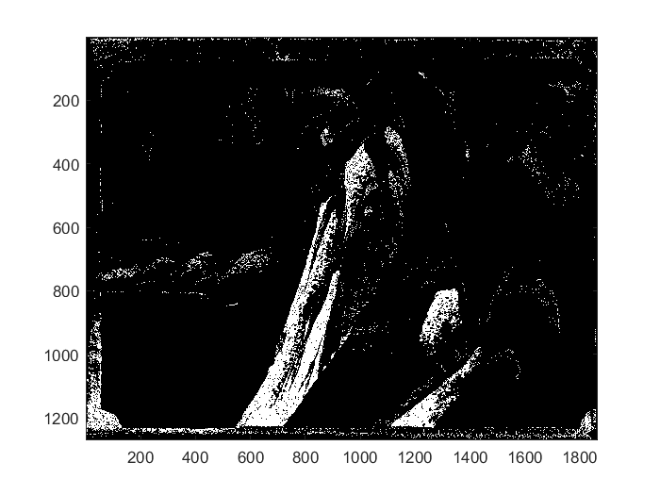
thresholding
Picks out areas outside the painting; low accuracy

Slide 10
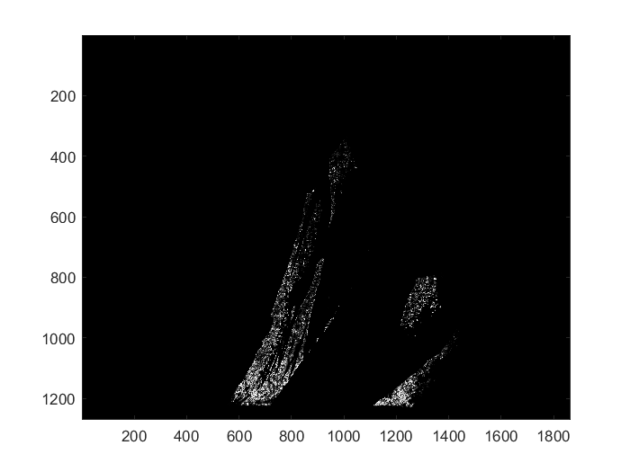
Parametric segmentation
More accurate than thresholding; low probabilities given to same colors, thus the dimness

Slide 11
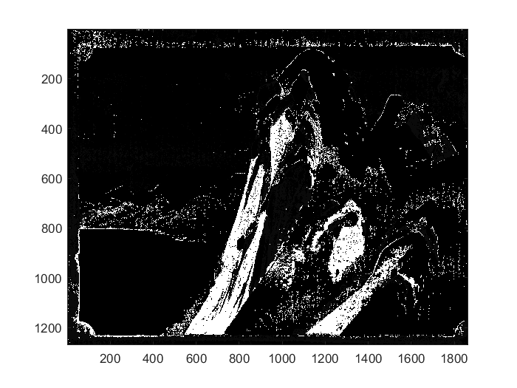
Histogram backprojection
Same colors in chromacity space correspond to white pixels; treats mountains at the back as same color

Slide 12
How is accuracy defined for color segmentation?

Slide 13
Parametric segmentation
Models the ROI histogram space as an ellipsoid; treats all pixels has having a probability that they belong to the ROI
Assumes the pixels’ colors are distributed Gaussian, with specified mean and standard deviation per color. However there are also covariances between colors which deteriorate the accuracy of the probability assignments.
We thus look at how these Gaussians behave when treated in a joint probability distribution.

Slide 14
Joint parametric segmentation
Calculate the mean and standard deviation per color. This results in a 1D Gaussian per color (as opposed to 3D Gaussian ellipsoid calculated earlier that includes covariances)
Multiply the probabilities per channel per pixel. You can adjust the range considered per histogram by adjusting the standard deviation per color.

Slide 15
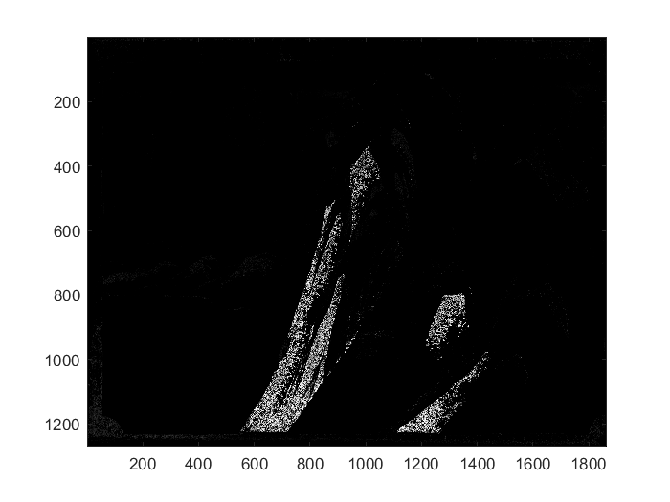
Joint parametric segmentation – 1 sigma
Looks the same as earlier; only brighter pixels due to higher probabilities due to loss of covariance

Slide 16
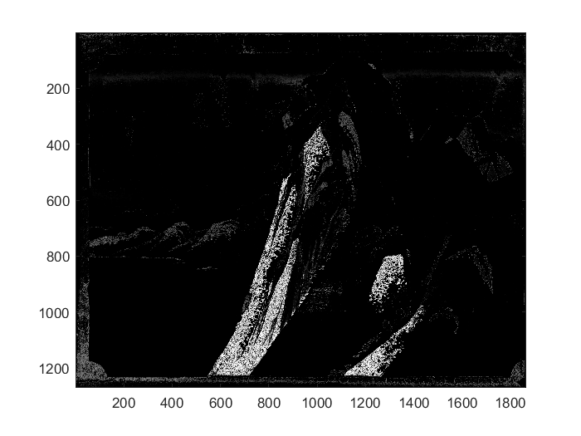
Joint parametric segmentation – 1.6 sigma
1.6 sigma = 90% of the range of the bell curve; already includes some backdrop mountains and background paper

Slide 17
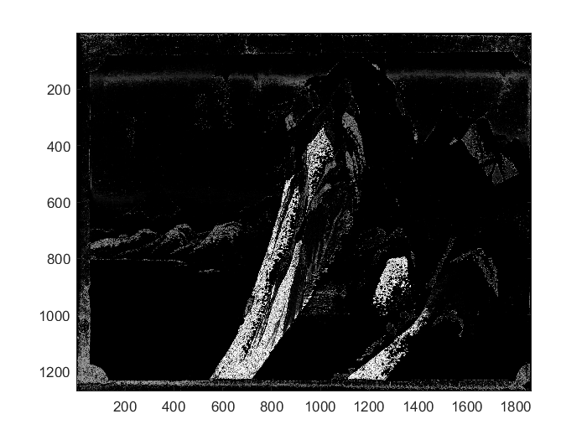
Joint parametric segmentation – 2 sigma
Backdrop mountains get brighter

Slide 18
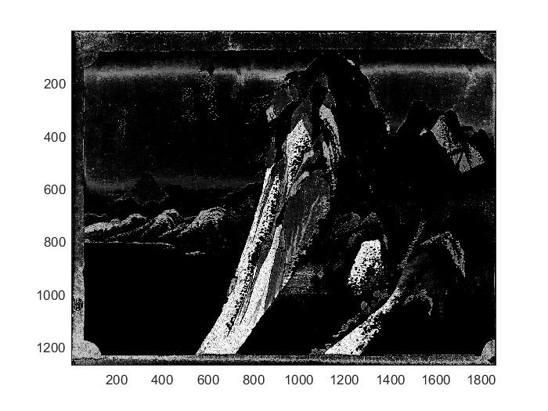
Joint parametric segmentation – 3 sigma
At this point, even the paper is being considered to have the same color as the ROI

Slide 19
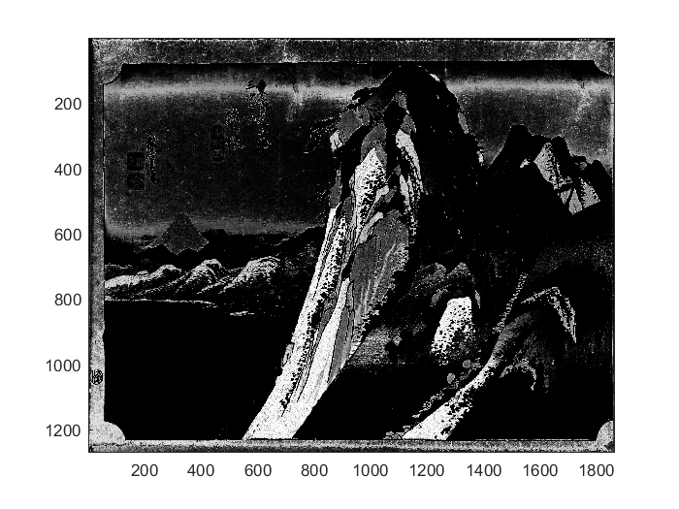
Joint parametric segmentation – 4 sigma
Painting gets clearer and clearer the more pixels we deem to be included in our probability distribution

Slide 20
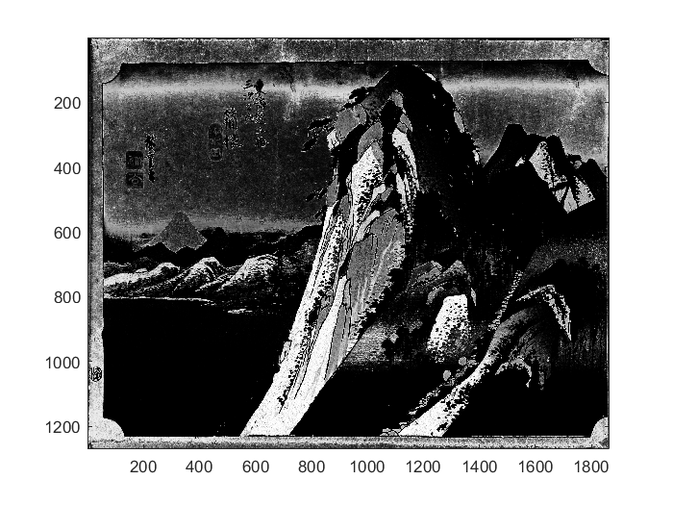
Joint parametric segmentation – 5 sigma
5 sigma = 99.99% of the bell curve is treated; gives the clearest picture and ROI

Slide 21
conclusions
Color segmentation can be applied to different image processing methods; each one can have a different purpose, so using the appropriate color segmentation technique can help
Parametric segmentation can help recover the image fully when used with the proper range (via choosing the standard deviation)
Histogram backprojection can help for a fast segmentation as we don’t need to model the ROI

